Slide 1

Lecture 1: Economics and the World of Business
Maryam Alhalboni PhD.
Maryam.Alhalboni @york.ac.uk
“If I had eight hours to chop down a tree, I’d spend six sharpening my axe.”
Abraham Lincoln

Slide 2
Lecture overview
The Economic Problem
Factors of production
Decision-Making Frameworks
Economic Branches
Traditional vs. Alternative Goals
Circular flow of income
Data in Practice

Slide 3
Tackling the problem of scarcity
The "Wish List" vs. The "Resources List“
Infinite Wants: Humans, firms, and governments have "wish lists" that are virtually boundless (e.g., luxury goods, better healthcare, global expansion).
Finite Resources: The means to achieve these wants (e.g., salary, tax receipts, shareholder funds) are strictly limited.
The "Gap": Economics is the study of how we manage the significant gap between what we want and what we can actually afford.
Defining Scarcity: The excess of human wants over what can actually be produced.

Slide 4
The Scarcity Problem Across Society
Individuals: Limited by income and time; must decide what to buy and what to "leave in the shop.“
Firms: Limited by access to capital (shareholder funds) and quality labor; must decide which products to develop or which countries to enter.
Governments: Limited by tax revenue; must choose between competing priorities like education, infrastructure, or healthcare.
Key Takeaway: Economics is the study of choice. Because we cannot have everything, we must decide how to allocate our finite resources most effectively.

Slide 5
The Factors of Production (Inputs)
To produce goods and services and satisfy society's wants, economists categorize limited resources into four:
1. Land (Raw Materials): All natural resources and raw materials used in production.
Examples: Oil, gas, base metals, and minerals.
Economic Impact: Some nations build their entire economy around resource extraction:
Saudi Arabia & Qatar: Oil and Gas.
Australia: Iron, copper, and coal.

Slide 6
The Factors of Production (Inputs)
2. Labour (Human Effort): The physical and mental effort used by people in production.
Volume vs. Quality:
Volume: Populous nations like India and China (hundreds of millions of workers) generate wealth through the sheer scale of economic activity.
Quality (Human Capital): Developed European economies focus on highly educated and skilled workers to produce high-value goods like aeronautics and banking services.

Slide 7
The Factors of Production (Inputs)
3. Capital (Man-made Resources): Tools, machinery, buildings, and technology used to produce other goods.
Global Examples:
IT Infrastructure: Critical for modern banking and retail.
Construction (Dubai): Massive expansion in offices, hotels, and retail space.
Infrastructure (China): Government investment in road, rail, and energy systems.

Slide 8
The Factors of Production (Inputs)
4. Enterprise (The Organizer): The factor that combines land, labour, and capital to produce goods/services for profit.
The Role of the Entrepreneur: Spotting new market opportunities.
Acting as innovators and risk-takers.
Shareholders: Provide the financial backing that enables this risk-taking.
Famous Visionaries:
Elon Musk (Tesla) & Jeff Bezos (Amazon).
Bill Gates (Microsoft) & Steve Jobs (Apple).
Mark Zuckerberg (Meta) & Michael O'Leary (Ryanair).

Slide 9
Q Which of the following is considered "Capital" as a factor of production?
A newly discovered oil field.
A skilled software engineer.
IT infrastructure and production machinery.
An entrepreneur starting a new company.
Notes:
9

Slide 10
Scarcity and Opportunity Cost
The Concept of Opportunity Cost
Sacrifice is Inevitable: Choosing more of one thing means having less of another due to limited resources.
Opportunity Cost is the value of the next best alternative sacrificed when making a choice.
Example (Consumer): The cost of a textbook is the pair of jeans you didn't buy.
Example (Worker): The cost of overtime is the leisure time lost.

Slide 11
Rational Decision Making
Weighing Costs vs. Benefits: Rationality means choosing options that provide the "best value" (greatest benefit relative to cost).
Economists focus on Marginal Costs and Marginal Benefits, the impact of doing a little bit more or a little bit less.
You weigh the benefit of an extra 10 minutes of sleep (Marginal Benefit) against the cost of a more stressful morning rush (Marginal Cost).
A car firm will produce an additional vehicle only if the Marginal Revenue (extra income) exceeds the Marginal Cost (extra labor/materials).

Slide 12
Q Assume that a firm can produce 6 units of good X or 12 units of good Y per hour with its current resources. What is the opportunity cost of a unit of X?
72 units of Y
12 units of Y
6 units of Y
2 units of Y
½ unit of Y
Notes:
12

Slide 13
The Two Branches of Economics
Microeconomics ("Small")
Focus: Examines individual "parts" of the economy.
Key Drivers: Analyzes the factors determining the demand and supply of specific goods and services (e.g., the market for cars or butter).

Slide 14
The Two Branches of Economics
Macroeconomics ("Big")
Focus: Examines the economy as a whole through "aggregates.“
Aggregate Demand: The total spending in the economy from all sources:
Consumers and Government.
Firms (investment in capital/materials).
Overseas customers (exports).
Aggregate Supply: The total national output of all goods and services produced within the economy.

Slide 15
Q Which one of the following is a microeconomic issue?
The government spends more than it receives in tax revenue.
House prices rise more rapidly.
Unemployment rises.
The Bank of England raises interest rates.
Imports exceed exports.
Notes:
15

Slide 16
Traditional Economics – The Growth Imperative
The primary measure of success is Gross Domestic Product (GDP) growth.
The Logic of "More": Markets should be "freed up" to allow firms to expand without restriction.
Increased production leads to higher profits, which are expected to drive higher wages and better living standards.
Focus on Consumption: Encourages a cycle of producing and consuming more goods and services to keep the economy moving forward.
The "Invisible Hand" Mentality: Assumes that if the economy grows and firms are profitable, society’s problems will naturally be solved through wealth creation.
Notes:
13

Slide 17
The Challenge and The Doughnut Alternative
The Critique of Growth: Kate Raworth (2017) argues that focusing solely on GDP fails to account for human well-being and the health of the planet.
The "Doughnut" Framework: A shift from "infinite growth" to "thriving in balance.“
The Social Foundation (The Inner Ring):
Economics must ensure no one falls short on life's essentials.
This includes guaranteed access to food, water, healthcare, education, and equality.
The Environmental Ceiling (The Outer Ring):
Economic activity must stop before it causes ecological collapse.
Limits are set to prevent climate change, chemical pollution, and loss of biodiversity.
A New Definition of Success: Instead of a rising line on a graph, success is staying within the "sweet spot“, the safe and just space where humanity and nature can survive together.
Notes:
13

Slide 18
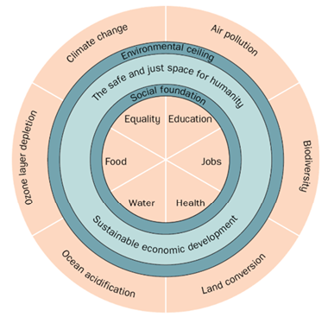
The Challenge and The Doughnut Alternative
Notes:
13

Slide 19
Types of Economic Systems
Planned Economy (Command): The government decides the production point.
Authorities determine which industries to support, set output targets, and often control prices and wages.
Examples: Cuba, North Korea, and historically the Soviet Bloc.
Market Economy (Free Market): Consumers and firms decide through buying and selling.
Resources (Land, Labour, Capital, Enterprise) naturally shift toward markets with the highest profit potential.
Prices act as signals: High consumer demand or lower costs draw more firms into a market.
Notes:
13

Slide 20
Types of Economic Systems
Mixed Economy: A blend of both systems used by most modern nations.
Market side: Private firms sell groceries or electronics based on demand.
Planned side: The government provides public services like health care, education, and defense.
Notes:
13

Slide 21
The Economic View of the Firm
A firm is seen as a balance of revenues and costs .
Objective of Business Economics: To analyze the micro and macro influences:
Enhance Revenues (e.g., pricing strategies, market demand).
Reduce Costs (e.g., resource efficiency, labor management).
The firm sits at the center of two distinct environments that impact its financial health:
Microeconomic Environment: Individual markets, competitors, and consumer behavior.
Macroeconomic Environment: National growth, inflation, and government policy.
Business economics aims to improve a firm's understanding of how to optimize its revenue or cost position within these environments.
Notes:
13

Slide 22
The Government's "Carrot and Stick"
Correcting Market Failures: Governments intervene when business activities (like pollution) harm society.
Policy Tools:
Taxes: Levied on firms that operate against public interest (e.g., polluters).
Subsidies/Grants: Provided to firms adopting environmentally friendly practices.
Impact: These interventions directly shift a firm's cost and revenue structure.
Notes:
13

Slide 23
The Circular Flow of Income
The "Twin" Relationship Between Households and Firms
The Goods Market:
Households demand goods and services.
Firms supply goods and services.
Exchange: Consumer expenditure (money) flows to firms; products flow to households.

Slide 24
The circular flow of goods and incomes
Goods and services
£
Consumer
expenditure

Slide 25
The Circular Flow of Income
The "Twin" Relationship Between Households and Firms
The Factor Market:
Firms demand factors of production (Labour, Land, Capital).
Households supply these factors.
Exchange: Firms pay households via wages, rent, interest, and dividends.

Slide 26
The circular flow of goods and incomes
Goods and services
Goods and services
£
Consumer
expenditure
Wages, rent
dividends, etc.
£
Services of factors of production (labour, etc)

Slide 27
The Mechanics of the Flow
Money circulates from households to firms and back again, while resources and products flow in the opposite direction.
If households spend more, firms earn more, leading to higher production and increased incomes (wages/profits) for households, which further boosts spending.
This interaction occurs in "markets," which can be physical (shops) or abstract (labor markets for specific professions like secretaries).

Slide 28
Q Which one of the following does NOT represent a flow of income earned by factors of production?
Wages earned by workers in a factory
Rent received by landowners
A machine sold by a firm
Profits earned by businesspeople
Salaries earned by lecturers
Notes:
28

Slide 29
Types of Economic Data
Economists use specific data structures to analyze the relationships between business variables:
Time Series Data: Measuring the same variable at various points in time.
Example: Annual cinema ticket prices from 1990–2025 or minute-by-minute share prices on the London Stock Exchange.
Cross-Sectional Data: Measuring different subjects at a single point in time.
Example: The profits of all major supermarket companies in the year 2025.
Panel Data: A combination of both; measuring a set of subjects (like supermarkets) consistently over multiple years.

Slide 30
Business data application: economic activity and the environment
The Power of Economic Data
Illustrating Trends: Data allows businesspeople to identify movements in key variables and predict future market conditions.
Practical Utility: Understanding where to find and how to interpret data is a core skill for solving real-world business problems.

Slide 31
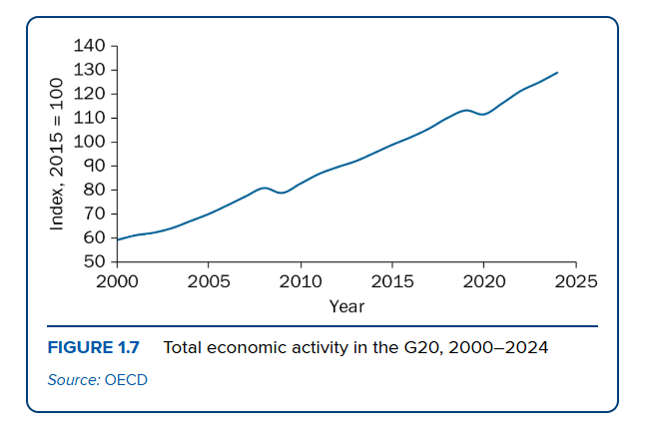
Business Data Application
G20 Economic Trends (2000–2024)

Slide 32
G20 Economic Trends (2000–2024)
The G20 Powerhouse: Represents 80% of global production and 75% of world trade.
Consistent Growth: Despite fluctuations, G20 economic activity (GDP) more than doubled over 25 years (Index 60 to 130).
Significant Disruptions:
2008–2009: Global Financial Crisis and banking collapses.
2020–2021: Global impact of the Covid-19 pandemic.

Slide 33
G20 Economic Trends (2000–2024)
The Positive Impacts of Expansion
Economic prosperity and upward GDP trends provide direct benefits to the business environment:
Revenue & Sales: Increased economic activity drives higher consumer spending and sales volume.
Profitability: Growth typically boosts firm-level profits and financial performance.
Social Benefits: Expansion leads to job creation, rising wages, and improved general living standards.

Slide 34
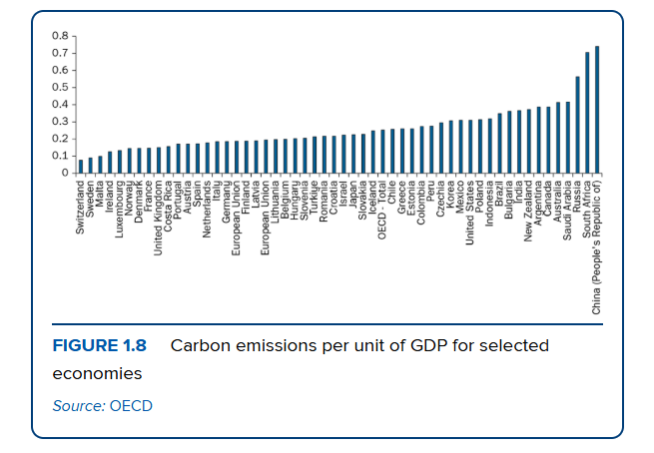
Business Data Application

Slide 35
The Environmental Challenge
Economic growth often comes with a "hidden" resource cost that businesses must recognize:
The Resource Loop: Growth in modern sectors (like data centres) significantly increases the demand for electricity.
Fossil Fuel Reliance: To meet this higher energy demand, there is often a corresponding surge in the exploration and extraction of fossil fuels.
Strategic Consideration: Businesses must balance the drive for "prosperity" with the long-term sustainability of the resources they consume.

Slide 36
Key Takeaways
Scarcity & Choice: Economics exists because resources are finite but human wants are boundless; every choice involves an opportunity cost.
Production Inputs: Land, Labour, Capital, and Enterprise are the essential factors combined by entrepreneurs to generate output and profit.
Strategic Environments: Firms operate at the center of micro (individual markets) and macro (aggregate economy) forces.
Economic Systems: Modern nations typically use a Mixed Economy, balancing private market efficiency with government-provided public services.

Slide 37
Questions

